Slide 1
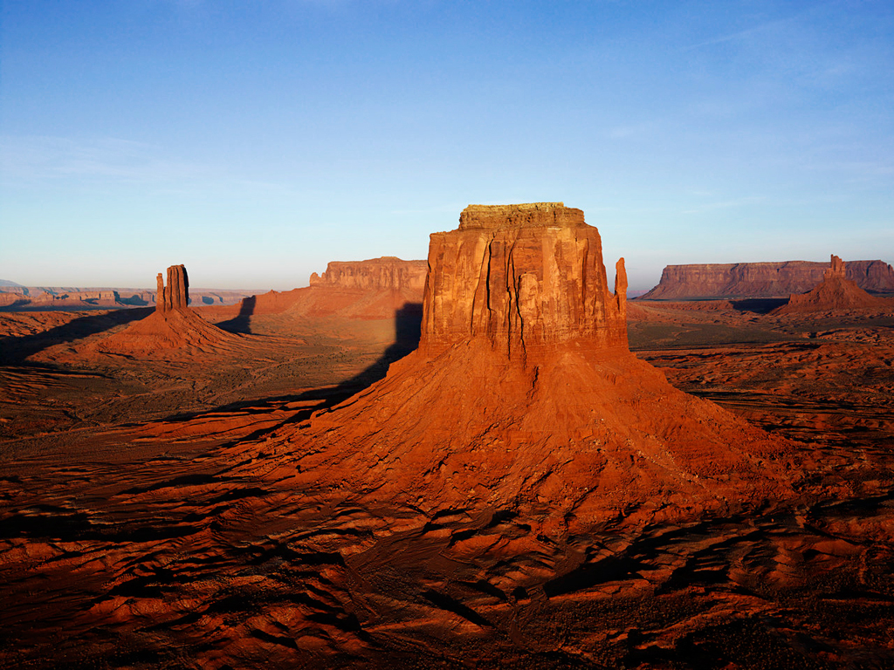
Arizona Public Service
Arizona Environmental Strategic Alliance Annual Report
Michael Denby
November 29, 2018

Slide 2
About APS
Providing power to Arizonians for over 130 years.
Providing power in 11 of the 15 counties in Arizona.
1.2 million customers
$18 Billion in consolidated assets
$3.56 billion in annual revenues
34,646 Square Miles of Service Territory
35,267 miles of transmission and distribution wires (24,900 miles around earth)
Notes:
Our People area includes our Communities, our Customers, and our Employees
In 2016, we worked with partners such as the Arizona Commerce Authority (ACA) and the Greater Phoenix Economic Council (GPEC) to create an estimated 5,000 new jobs and drive
more than $1 billion in capital investment in APS service territory.

Slide 3
Economic Impact
In 2017 APS partnered with Greater Phoenix Economic Council and Arizona Commerce Authority to welcome 21 new companies to the state, adding an estimated:
39.8 MW
4,300 new jobs
$659.9M in capital investment
Notable corporations include UPS, Ball Corporation, Aldi and Chewy.com
Notes:
1887

Slide 4
Economic Indicators
Arizona and Metro Phoenix remain attractive places to live and do business
Year over Year Employment Growth
✓
Maricopa County ranked #1 in U.S. for population growth for second straight year
- U.S. Census Bureau March 2018
✓
Arizona is a top 5 state in personal income growth
- U.S. Bureau of Economic Analysis March 2018
✓
Above-average job growth in tourism, health care, manufacturing, financial services, and construction
Single Family & Multifamily Housing Permits
Maricopa County
✓
2017 housing construction at highest level since 2007
✓
Arizona #1 state in the country in 2017 for in-bound moves
- North American Moving Services January 2018
E
Notes:
1887

Slide 5
About APS

Slide 6
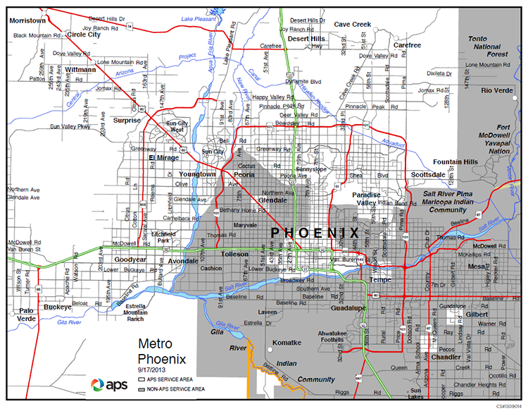
About APS

Slide 7
Population/Load Growth
We forecast population growth in the metro area of 39 percent through 2032, from 1.2 million APS customers today to 1.7 million by 2032.
Those new customers are expected to increase normal-weather peak demand by 51 percent, to 10,541 megawatts.
We expect 340,000 new customers and a 30% increase in our customer’s energy needs by 2030.

Slide 8
Carbon Reduction
The company’s 2017 Integrated Resource Plan details our comprehensive strategies to meet customers’ projected energy needs, fulfill regulatory targets and manage environmental impacts over the next 15 years. The plan is projected to reduce our carbon intensity by 23 percent.

Slide 9
Progress and Achievements
Five critical areas of our sustainability efforts
Carbon Management
Plan to reduce carbon intensity by 23% over the next 15 years MSCI Environmental Sustainability and Governance A rating¹
Energy Innovation
More than 1,300 MW of installed solar capacity Plan to add over 500 MW of energy storage in next 15 years
Safety & Security
Nearly 70% reduction in OSHA recordable injuries over past 10 years Remain top decile for safety performance in U.S. electric utilities industry
Water Resources
14% reduction in groundwater use since 2014 20 billion gallons of water recycled each year to cool Palo Verde
People
Average employee tenure of 13 years due to strong talent strategy More than 20% of our employees are veterans
Board of Directors Nuclear and Operating Committee Charter
was amended in 2018
to assign oversight of sustainability initiatives and strategy
We continue to be
recognized for our
sustainability leadership
Obtained a “Leadership”
rating from CDP for
climate change and water management — one of only two U.S. utilities to
earn the highest rating in both categories
¹ As of October 27, 2017

Slide 10
CLEAN ENERGY
Looking ahead to Arizona’s growing population and expanding economic activity, APS continues supporting resources and technology to ensure our energy is clean, reliable and affordable for all Arizonans
The Palo Verde Generating Station provides more than 70% of Arizona’s carbon-free energy and uses recycled wastewater to cool the plant
Today, we serve customers with an energy mix that is 50% clean
Our 10 grid-scale solar plants are powered by more than 1 million solar panels
We are accomplishing this through innovative customer programs, next-generation energy efficiency programs, energy storage, the APS Solar Partner and APS Solar Communities programs and microgrids

Slide 11
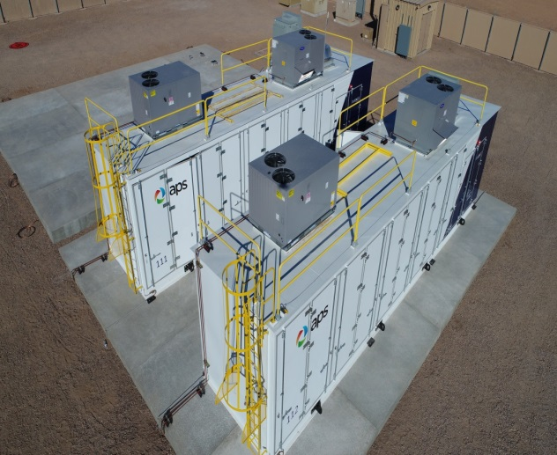
Storage Projects
We are leading the solar-plus-battery-storage effort, advancing innovation and conducting ground-breaking research
Up to 106 MW located on APS solar plant sites
Utility owned
Anticipated in-service by June 2020
2018 Battery Storage RFP
2 MW/8 MWH lithium ion battery
Placed in service March 2018
Deferred the rebuild of around 20 miles of 21 kV distribution line for approximately 5-10 years
Acts as generating capacity to the system
Helps regulate the voltage on the feeder
Punkin Center Battery Storage Project
50 MW battery energy storage; 65 MW solar
15-year power purchase agreement
Anticipated in-service 2021
APS will be able to store power and deliver energy during peak hours (3-8 p.m.)
APS, First Solar Battery Storage Project

Slide 12
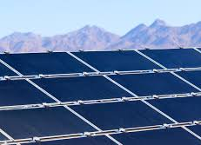
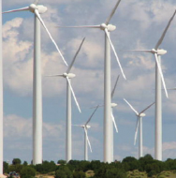
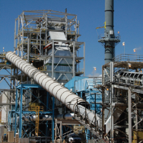
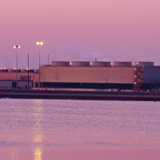
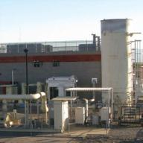
Renewable resources
APS Solar Portfolio*
APS currently has 1,683 MW of renewable resources:
Owned
239 MW
PPA
310 MW
Solar* | 1,364 MW
Wind | 289 MW
Biomass | 14 MW
Geothermal | 10 MW
Biogas | 6 MW
DG
815 MW
Owned solar includes 170 MW AZ Sun Program, 25 MW of APS owned Distributed Generation (DG), 4 MW of other APS owned utility scale solar and 40 MW Red Rock Solar Plant;
PPA is primarily 250 MW Solana Concentrated Solar Facility
Yuma Foothills
Solar
35 MW
Aragonne Mesa
Wind
90 MW
Snowflake Biomass
14 MW
Salton Sea Geothermal
10 MW
Glendale Landfill
Biogas
3 MW
* As of 9/30/18 as reported in the Third Quarter 2018 Form 10-Q – with additional 110 MW under development

Slide 13
State of Renewables
SRP announced 1,200 MW of solar by 2025.
SRP currently has about 200 MW of solar.
APS has 1,400 MW of solar in our service territory today including over 85,000 roof-top DG customers.
SRP plans to get 32 % of its generation from clean sources. Our energy mix is already over 50% clean.
SRP has 10 MW of storage in service and 35 under construction.
APS has over 250 MW of storage and will have over 300 when First Solar project complete.
Nov 21 - AZ Republic article

Slide 14
Residential PV Applications¹
YTD
¹ Monthly data equals applications received minus cancelled applications. As of September 30, 2018, approximately 83,100 residential grid-tied solar photovoltaic (PV) systems have been installed in APS’s service territory, totaling approximately 661 MWdc of installed capacity. Excludes APS Solar Partner Program residential PV systems.
Note: www.arizonagoessolar.org logs total residential application volume, including cancellations. Solar water heaters can also be found on the site, but are not included in the chart above.

Slide 15
Customer Programs
Introduced more programs that benefit both customers and the Company
Smart Thermostats with Demand Response and Pre-Cooling
Customer Benefits
Bill credit of $25/year in exchange for demand response
APS Benefits
Partner with customers to reduce system load during peak periods
Behind the Meter Battery Systems
Customer Benefits
Receive battery and one-time incentive of $500 in exchange for joint use of the battery
APS Benefits
APS will own, operate, and maintain the battery systems
Batteries will help integrate solar resources
Utilize battery storage as a load-balancing mechanism during peak hours
Residential Grid-Interactive Water Heaters
Customer Benefits
Bill savings opportunities
Customers receive free heat pump water heaters
APS Benefits
APS operates water heaters when energy is abundant avoiding peak periods
Innovative load management initiative

Slide 16
Demand Side Management (DSM)
2018 DSM Plan shifts the focus to align with APS’s changing resource needs
School Bus Electrification
Pilot program to electrify school buses that can charge in the middle of the day
Managed EV Charging Program
Fleet, workplace and multifamily charging infrastructure
Utility controlled providing additional demand response
Reverse Demand Response Pilot
Customers take advantage of negative pricing events
Energy Storage Initiative Expansion
Focus on C&I energy storage and control
ELECTRIC VEHICLE FLEET
2018 DSM Plan introduces new high value pilot programs to utilize the mid-day overproduction of energy

Slide 17
The “Duck Curve”
Distributed generation is changing the load shape of the grid
Current Spring Day
Spring Day 2022
Excess renewables create over-generation challenges …
… and potentially for nuclear generation in the future
Nuclear Output
Nuclear Output
Hour
Hour

Slide 18
Distribution Grid Investments
Grid Operations and Investment Projected to be $1.6 billion from 2018-2020
Customer Growth Grid Modernization Run and Maintain Approximately 51% of distribution capex Approximately 9% of distribution capex Approximately 40% of distribution capex
R
T
Reclosers – Supervisory Controlled Switches, Trip Savers
Average annual spend ~ $13M
Advanced Distribution System Platform
Project in planning phase
Cap Bank Controllers, Substation Regulators, Voltage Management Algorithms
Average annual spend ~ $7M
Automated switches controlled from the Distribution Operations Center
Manage load without sending field personnel to manually operate the switch
Integrated operational platform
Increases efficiency and life of distribution system; improves safety and communication; increases ability to manage overall reliability; and enables Distributed Energy Resources
Controls regulators and capacitor banks to manage power quality such as power factor and voltage
Monitors – Transformers, Breakers, Bushings
Average annual spend ~ $0.5M
Communications Backhaul
Average annual spend ~ $4M
Sensors – Current, Voltage
Average annual spend ~ $2.5M
New technologies such as APS’s Transformer Oil Analysis & Notification system leverage advances in communications and sensing to remotely monitor health of transformers, enabling proactive maintenance actions to prevent critical failures and increase reliability
Leveraging AMI for distribution automation
Strategically deploying Fiber for communications backhaul
Transitioning to Internet Protocol based networks for future growth & scalability
Line sensors to measure & identify fault current, fault location and voltage
Improves outage restoration time and operations efficiency

Slide 19
Ocotillo Modernization Project and Four Corners SCRs
In 2017 two large generation-related capital investments
Ocotillo Modernization Project: Retiring two aging, steam-based, natural gas units, and replacing with 5 new, fast-ramping, combustion turbine units
Four Corners Power Plant: Installed Selective Catalytic Reduction (SCR) equipment to comply with Federal environmental standards
 | Ocotillo Modernization Project | Four Corners SCRs
In-Service Dates | Units 6, 7 – Fall 2018 Units 3, 4 and 5 – Spring 2019 | Unit 5 – Late 2017 Unit 4 – Spring 2018
Total Cost (APS) | $500 million | $400 million
Estimated Cost Deferral | $45 million (through 2019) | $30 million (through 2018)
Accounting Deferral | Cost deferral from date of commercial operation to the effective date of rates in next rate case Includes depreciation, O&M, property taxes, and capital carrying charge² | Cost deferral from time of installation to incorporation of the SCR costs in rates using a step increase beginning in 2019 Includes depreciation, O&M, property taxes, and capital carrying charge²
¹ The ACC’s decision is subject to appeals.
² APS will calculate the capital carrying charge using the 5.13% embedded cost of debt established in the 2017 Rate Review Order.

Slide 20
Carbon Avoidance and Emission Reductions
APS has reduced carbon dioxide emissions by 35% since 2005
Carbon Avoidance Metric
Metric used to measure our overall carbon reduction, not just generation but Company wide
Carbon Avoidance Opportunities
Retiring coal plants
Renewable energy generation
Purchase power agreements
Energy efficiency programs for customers
Energy efficient buildings
Fleet electrification
Since 2015 APS has avoided 13.6 million metric tons of carbon dioxide emissions that would have been emitted – equivalent of removing almost 3 million automobiles from the road
Clean Energy
Since 2005 we have reduced
CO2 emissions by 35%
SO2 emissions by 78%
NOx emissions by 56%
As a result of the recent emission controls added to our Four Corners Plant, by 2019 we expect NOx emission to be reduced by 80% compared to 2005
Tons CO2 (‘000 tons)

Slide 21
Water Strategy
APS, and Palo Verde in particular, has provided national and international leadership on the use of reclaimed water for power generation
Vision: APS continues to strive for sustainable and cost-effective water supplies for energy production for APS customers
Mission: To execute a strategic water resource management program that provides APS timely and reliable information to manage our water resources portfolio efficiently and effectively, and helps ensure long-term water supplies and water contingency plans for each of our facilities, even in times of extended drought
Each APS power plant has a unique water strategy, developed to promote efficient and sustainable use of water. Since 2014, we have reduced groundwater use by 14%
APS 2017 Fleet
Water Use By Source Type
Water Usage and Intensity: Our goal is to reduce water intensity company-wide by 30% by 2032 compared to a 2014 baseline
Palo Verde Generating Station: The only nuclear power plant in the world that is not located next to a large body of water. Instead, it uses treated effluent, or wastewater, from several area municipalities, recycling approximately 20 billion gallons of wastewater each year
Ocotillo Modernization Project: State-of-the-art hybrid cooling technology for new units being constructed will decrease water use from 900 gallons per MWh to 140 per gallon per MWh, a reduction of more than 80%

Slide 22
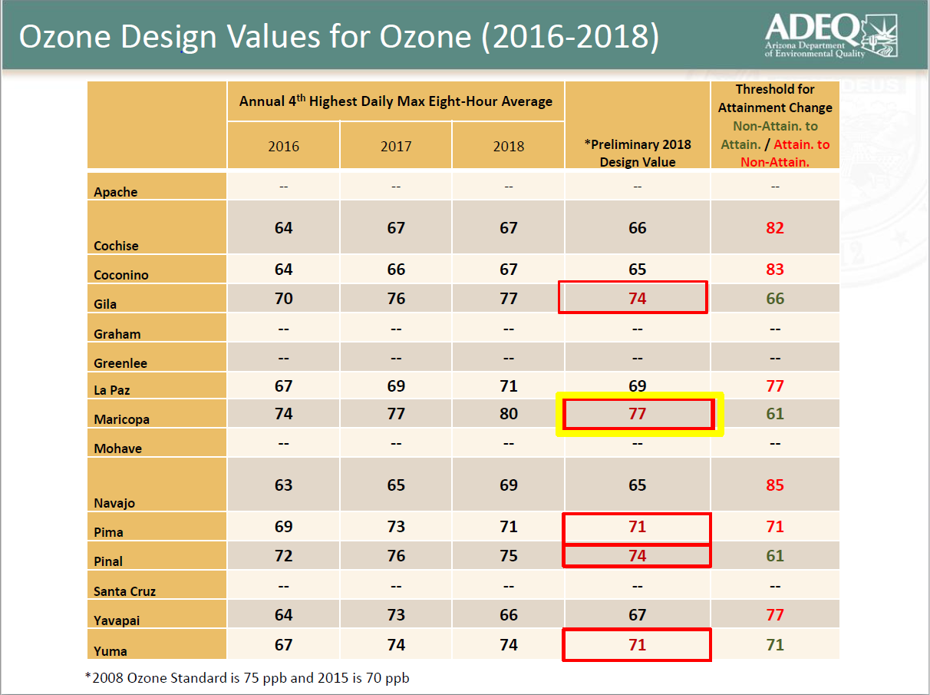
Ozone Strategy
Impacts health of residents
Limits growth of business
Limits growth of valley
Working with ADEQ, Maricopa County, Industry, Chamber, and others.
To develop plan that reduces NOx and VOCs. Promotes growth. Encourages voluntary engagement.

Slide 23
Generation portfolio*
 | Plant | Location | No. of Units | Dispatch | COD | Ownership Interest¹ | Net Capacity (MW)
NUCLEAR 1,146 MW | Palo Verde | Wintersburg, AZ | 3 | Base | 1986-1989 | 29.1% | 1,146
COAL 1,672 MW | Cholla | Joseph City, AZ | 2 | Base | 1962-1980 | 100 | 387
 | Four Corners | Farmington, NM | 2 | Base | 1969-1970 | 63 | 970
 | Navajo | Page, AZ | 3 | Base | 1974-1976 | 14 | 315
GAS - COMBINED CYCLE 1,871 MW | Redhawk | Arlington, AZ | 2 | Intermediate | 2002 | 100 | 984
 | West Phoenix | Phoenix, AZ | 5 | Intermediate | 1976-2003 | 100 | 887
GAS - STEAM TURBINE 220 MW | Ocotillo | Tempe, AZ | 2 | Peaking | 1960 | 100 | 220
GAS / OIL COMBUSTION TURBINE 1,088 MW | Sundance | Casa Grande, AZ | 10 | Peaking | 2002 | 100 | 420
 | Yucca | Yuma, AZ | 6 | Peaking | 1971-2008 | 100 | 243
 | Saguaro | Red Rock, AZ | 3 | Peaking | 1972-2002 | 100 | 189
 | West Phoenix | Phoenix, AZ | 2 | Peaking | 1972-1973 | 100 | 110
 | Ocotillo | Tempe, AZ | 2 | Peaking | 1972-1973 | 100 | 110
 | Fairview | Douglas, AZ | 1 | Peaking | 1972 | 100 | 16
SOLAR 239 MW | Hyder & Hyder II | Hyder, AZ | - | As Available | 2011-2013 | 100 | 30
 | Paloma | Gila Bend, AZ | - | As Available | 2011 | 100 | 17
 | Cotton Center | Gila Bend, AZ | - | As Available | 2011 | 100 | 17
 | Chino Valley | Chino Valley, AZ | - | As Available | 2012 | 100 | 19
 | Foothills | Yuma, AZ | - | As Available | 2013 | 100 | 35
 | Distributed Energy | Multiple AZ Facilities | - | As Available | Various | 100 | 25
 | Gila Bend | Gila Bend, AZ | - | As Available | 2015 | 100 | 32
 | Luke Air Force Base | Glendale, AZ | - | As Available | 2015 | 100 | 10
 | Desert Star | Buckeye, AZ | - | As Available | 2015 | 100 | 10
 | Red Rock | Red Rock, AZ | - | As Available | 2016 | 100 | 40
 | Various | Multiple AZ Facilities | - | As Available | 1996-2006 | 100 | 4
 | Total Generation Capacity |  |  |  |  |  | 6,236 MW
* As disclosed in 2017 Form 10-K.
¹ Includes leased generation plants

Slide 24
Purchased Power Contracts*
 | Contract | Location | Owner/Developer | Status¹ | PPA Signed | COD | Term (Years) | Net Capacity (MW)
SOLAR 310 MW | Solana | Gila Bend, AZ | Abengoa | IO | Feb-2008 | 2013 | 30 | 250
 | RE Ajo | Ajo, AZ | Duke Energy Gen Svcs | IO | Jan-2010 | 2011 | 25 | 5
 | Sun E AZ 1 | Prescott, AZ | SunEdison | IO | Feb-2010 | 2011 | 30 | 10
 | Saddle Mountain | Tonopah, AZ | SunEdison | IO | Jan - 2011 | 2012 | 30 | 15
 | Badger | Tonopah, AZ | PSEG | IO | Jan-2012 | 2013 | 30 | 15
 | Gillespie | Maricopa County, AZ | Recurrent Energy | IO | Jan-2012 | 2013 | 30 | 15
WIND 289 MW | Aragonne Mesa | Santa Rosa, NM | Ingifen Asset Mgmt | IO | Dec-2005 | 2006 | 20 | 90
 | High Lonesome | Mountainair, NM | Foresight / EME | IO | Feb-2008 | 2009 | 30 | 100
 | Perrin Ranch Wind | Williams, AZ | NextEra Energy | IO | Jul-2010 | 2012 | 25 | 99
GEOTHERMAL 10 MW | Salton Sea | Imperial County, CA | Cal Energy | IO | Jan-2006 | 2006 | 23 | 10
BIOMASS 14 MW | Snowflake | Snowflake, AZ | Novo Power | IO | Sep-2005 | 2008 | 15 | 14
BIOGAS 6 MW | Glendale Landfill | Glendale, AZ | Glendale Energy LLC | IO | Jul-2008 | 2010 | 20 | 3
 | NW Regional Landfill | Surprise, AZ | Waste Management | IO | Dec-2010 | 2012 | 20 | 3
INTER-UTILITY 540 MW | PacifiCorp Seasonal Power Exchange | - | PacifiCorp | IO | Sep-1990 | 1991 | 30 | 480
 | Not Disclosed | Not Disclosed | Not Disclosed | IO | May-2009 | 2010 | 10 | 60
CONVENTIONAL TOLLING 1,695 MW | CC Tolling | Not Disclosed | Not Disclosed | IO | Aug-2007 | 2010 | 10 | 560
 | CC Tolling | Arlington, AZ | Arlington Valley | IO | Dec-2016 | 2020 | 6 | 565
 | CC Tolling | Not Disclosed | Not Disclosed | IO | Dec - 2017 | 2020 | 7 | 570
DEMAND RESPONSE 25 MW | Demand Response | Not Disclosed | Not Disclosed | IO | Sep-2008 | 2010 | 15 | 25
SOLAR PLUS BATTERY STORAGE 65 MW | Solar Plus Battery Storage | Arlington, AZ | First Solar | UD | Feb – 2018 | 2021 | 15 | 65
 | Total Contracted Capacity |  |  |  |  |  |  | 2,954 MW
* As disclosed in 2017 Form 10-K.
¹ UD = Under Development; UC = Under Construction; IO = In Operation

Slide 25
APS Owned Generation Capacity
Solar
239 MW
Total Generation Capacity 6,236

Slide 26
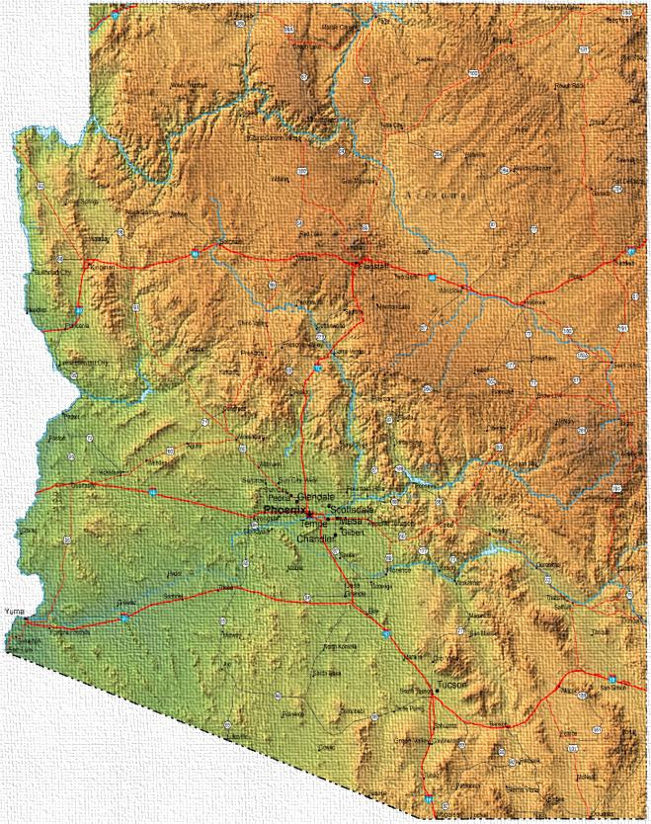
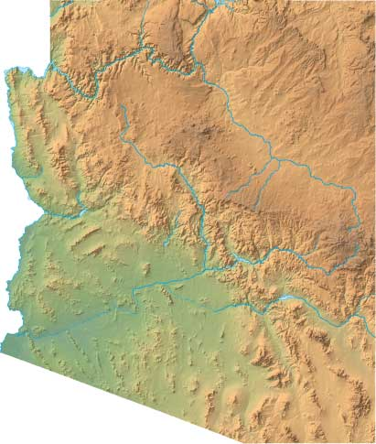
Renewable Generation Assets
Total portfolio 1,302 MW AC
88 MW planned/under development
Chino Valley
Luke AFB
Hyder I & II
Desert Star
Cotton Center
Paloma
Gila Bend
GBII
Foothills
Arizona Sun Facilities
Notes:
Data from Q1 2016 10Q SEC worksheet
Included in numbers is 170 MW of solar resources procured through the AZ Sun Program.
Includes 250 MW from the Solana Generating Station, which achieved commercial operation in October 2013.
Distributed generation is produced in DC and is converted to AC for reporting purposes.
Distributed generation MWDC capacity is converted to MWAC capacity for reporting purposes.
DE Solar: third party owned is 451 MW and two agreements (Bagdad & Sun Power) 33 MW.
1 – Paloma 17MW AC
located in Gila Bend
2 – Cotton Center 17MW AC
located in Gila Bend
3 – Hyder I 16MW AC
located in Roll
4 – Chino Valley 19MW AC
located in Chino Valley
5 – Foothills 35MW AC
located in Yuma
6 – Hyder II 14MW AC
located in Roll
7 – Gila Bend 42MW AC
located in Gila Bend
8 – Desert Star 10MW AC
located in SW Phoenix
9 – Luke AFB 10MW AC
located in Glendale

Slide 27
Arizona Public Service
michael.denby@aps.com

